Slide 1
3rd Call for Proposals – Phase I
Information Session
April 7, 2025

Slide 2
Meeting Guidelines
Please add your Organization’s name to your User Name. Keep your camera off and your microphone muted. The meeting will be conducted in English. If interpretation is required, please select the language of your preference by following the instructions below: In your meeting/webinar controls, click Interpretation; Click the language of your choice; To hear the interpreted language only, click Mute Original Audio. Please send your questions via chat – you may write your question in English, French or Spanish; any questions not will be included in the FAQ document which will be posted on our website. Thank you for joining!

Slide 3
Agenda: CfP3 - Phase I Info Session
Welcome and Overview of the Pandemic Fund CfP3 – Phase I: General Principles and Scope Implementation and Monitoring & Evaluation Scoring & Weighting Methodology How to Access the CfP3 - Phase I Application Portal Q&A

Slide 4
Welcome and Overview of the Pandemic Fund
01

Slide 5


Our Story So Far…
COVID-19 highlighted
how ill-prepared the
world was to detect and contain a virus, and underscored the costs
of not being prepared.
Experts predict more than
a 50% chance of another
COVID-like pandemic in the
next 20-25 years – the risk is heightened by global challenges
like climate change, migration,
and antimicrobial resistance (AMR).
And yet, pandemic preparedness, prevention and response (PPR) continues to suffer from chronic under-investment, especially in low- and middle-income countries.
APRIL 2022
G20 Finance Ministers asked
the World Bank to explore setting up a Financial Intermediary Fund (FIF).
30 JUNE 2022
The World Bank’s board approves the proposal to establish The Pandemic
Fund (PF) as a FIF.
13 NOVEMBER 2022
Formally launched at a high-level event in Bali, Indonesia.
PRESENT DAY
Over US$2 billion raised.
US$885 million awarded in total grants, which mobilized additional financing of over US$6 billion to help 75 countries strengthen PPR capacity.
Third call launched in March 2025 with a US$500 million envelope
8-9 SEPTEMBER 2022
The Pandemic Fund
was formally established; first meeting of the governing board was held The World Bank hosts the secretariat
and serves as trustee and one of the implementing entities.

Slide 6




Pandemic Fund Mission
We provide a dedicated stream of additional grant funding for pandemic PPR in Low Income Countries (LIC) and Lower-Middle Income Countries (LMIC).
Support capacity building and implementation of pandemic Prevention, Preparedness and Response (PPR) in line with the International Health Regulations (IHR) and other internationally endorsed legal frameworks, and consistent with a One Health approach.
How we work
Mobilize funding from both Official Development Assistance (ODA) and non-ODA sources, including innovative finance
Crowd-in catalytic financing from international institutions as well as domestic investments
Foster coordination amongst PPR investors and allocate funding in response to country/region requests.
Strengthen global advocacy for continued PPR investment

Slide 7
In the first two years, the Pandemic Fund has allocated
47
Grants
75
Countries
$885M
Funds Allocated
$3.68B
Co-Financing
$2.4B
Co-Investment
6.96B
Total amount mobilized
7x
Leverage ratio
Geography
Income Level*
IEs
Mpox projects
Tags
Region | % of Proposals | % Funding Allocated
SSA | 34% | 43%
ECA | 8% | 7%
LAC | 19% | 15%
MNA | 13% | 12%
SAR | 13% | 11%
EAP | 13% | 11%
IC | % IC | % $$
LIC | 26% | 35%
LMIC | 49% | 45%
UMIC | 25% | 20%
85%
2 or more IEs
45%
mix of IEs/MDBs
5
Projects awarded under mpox fast-track
10
Beneficiary countries
30%
amount of grant allocated to emergency response
85%
Projects include One Health
91%
Projects include Community Engagement
*Only includes single-country grants
80% of grants to LIC/LMICS
Note: Data exclude multi-country and Regional Entity proposals that span multiple income groups

Slide 8
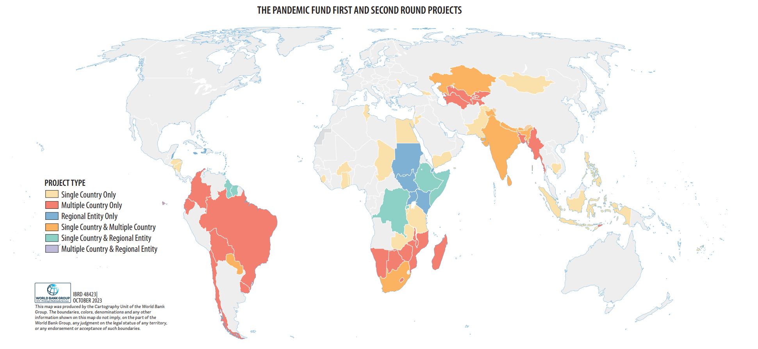
Current Portfolio (CfP1 and CfP2)

Slide 9
3rd Call for Proposals – Phase I
02

Slide 10








Timeline for CfP3 - Phase I
1
2
3
4
Call for Proposals announced on December 19th 2024
Application portal and CfP guidance released on March 26, 2025
Deadline to submit proposals via the application portal June 6, 2025 at 23:39 ET
Secretariat screens proposals for eligibility and may contact applicants for additional information
June 9 – 30, 2025
5
6
7
8
TAP undertakes a technical evaluation of all eligible proposals and submits final recommendations
July – October 2025
Secretariat prepares scenarios as needed and shares with Governing Board by mid October 2025
Board meets and makes funding allocation decisions; awarded proposals are notified in early November 2025
Awarded projects have received all required approvals and are ready to begin implementation by March 31, 2026

Slide 11
Key Parameters of CfP3 -- Phase I
Eligibility
Countries eligible to receive funding from IBRD and/or IDA are eligible to apply
The thirty-nine (39) countries that received single-country grants under the 1st and 2nd Call for Proposals are not eligible* to apply for single-country grants under the 3rd CfP, but they may apply for a Multi-country grant
Funding Envelope and Ceiling
The total envelope for the 3rd CfP (Phase I & Phase II) is US$ 500 million
Single-country proposals may request up to US$ 25 million
Multi-country proposals may request up to US$ 40 million
Types of Proposals Accepted
Single-country proposal : one country and one or more Implementing Entities (Phase I)
Multi-country proposal : two or more countries and one or more Implementing Entities (Phase I)
Proposal Limits
An individual country may submit a maximum of one single-country proposal
An individual country may participate in a maximum of one multi-country proposal
*Not eligible for a single-country grant under the 3rd CfP: Bhutan, Burkina Faso, Burundi, Cabo Verde, Cambodia, Chad, Democratic Republic of Congo, Egypt, Ethiopia, Fiji, Ghana, Georgia, Guyana, Honduras, India, Indonesia, Jordan, Kazakhstan, Lebanon, Moldova, Mongolia, Nepal, Nicaragua, Pakistan, Paraguay, Philippines, Rwanda, Samoa, Sierra Leone, South Africa, Sri Lanka, Suriname, Tanzania, Togo, Trinidad and Tobago, Tunisia, West Bank and Gaza, Yemen and Zambia

Slide 12
Eligible Implementing Entities
13 currently approved IEs:
  African Development Bank
  Asian Development Bank
  Asian Infrastructure Investment Bank
  European Investment Bank
  Inter-American Development Bank
  International Finance Corporation
  World Bank
  Food and Agriculture Organization of the United Nations
  UNICEF
  World Health Organization
  The Coalition for Epidemic Preparedness Innovations
  Gavi, the Vaccine Alliance
  Global Fund to Fight AIDS, Tuberculosis and Malaria.

Slide 13



Three Priority Areas
Early Warning and Disease Surveillance Systems
(human and animal)
Laboratory systems (human and animal)
Human Resources / Public Health and Community workforce capacity (human and animal)
National Public Health Institutes (or relevant public institutions)
Programmatic priorities should strengthen
Regional/Global networks organizations or hubs
Four (4) underlying themes as defined in the Pandemic Fund Strategic Plan

Slide 14
Key Principles of Sound Proposals
1
Promote a coordinated, collaborative and coherent approach to pandemic PPR:
Proposals should bring together key actors engaged in PPR and health systems financing, linking financing with existing, country/regional level planning and prioritization processes, thereby strengthening alignment and complementarity and creating conditions for a more systematic dialogue about domestic/regional financing for PPR.
This means a demonstration of collaboration:
among concerned Implementing Entities, leveraging the comparative strengths of each entity;
among concerned domestic agencies/actors, and
between concerned international and domestic (country/regional) actors
2
Demonstrate catalytic effect:
Proposals should demonstrate how the Pandemic Fund grant would mobilize a) co-financing and b) co-investment.

Slide 15
Co-Financing and Co-Investment
Co-Financing:
Financial contribution from Implementing Entities (IEs) and/or other external sources - such as bilateral aid agencies, philanthropies, and private sector funders [in support of the project].
  Consists of in-cash contributions and/or valued in-kind.
  Examples:
    Cash.
    Technical assistance.
    Procurement of reagents and other laboratory consumables.
Co-Investment:
Financial resources including on-budget government funds that are available for implementation of the project.
  Consists of budget in-cash, in-kind, and /or policy commitments linked to the Pandemic Fund project.
  Examples:
    Cash.
    Human resources, technical expertise, training programs, and equipment.
    Commitment to real-time data-sharing under a One Health approach.

Slide 16
What are key changes between CfP3 and CfP2?
Area of the 3rd Call for Proposals (CfP) | Change from 2nd CfP | Explanation
Priority Areas | Yes / No | Early Warning & Disease Surveillance Systems, Laboratory Systems, and Human Resources/Public Health and Community Workforce; two cross-cutting enablers and four underlying themes (updated)
Types of Proposals allowed | Yes | Phase I will only accept Single-country and Multi-country proposals; Regional Entity proposals will be accepted in Phase II
Submission Limits | Yes / No | An individual country may submit a maximum of one single-country proposal An individual country may participate in a maximum of one multi-country proposal
Co-financing and Co-investment guidance | Yes / No | Target portfolio leverage ratios for co-financing (1:5) and co-investment (1:4) included in Guidance Note and Scoring & Weighting Methodology, with different targets provided based on country income level; no target proportions given for in-cash vs. in-kind. Reminder that these targets are NOT mandatory.

Slide 17
Implementation and Monitoring & Evaluation
03

Slide 18
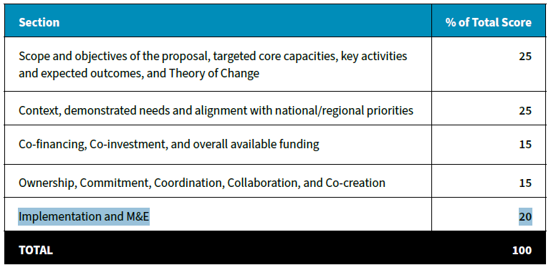
Implementation and M&E Scoring

Slide 19
Pandemic Fund Results Framework
Click here

Slide 20
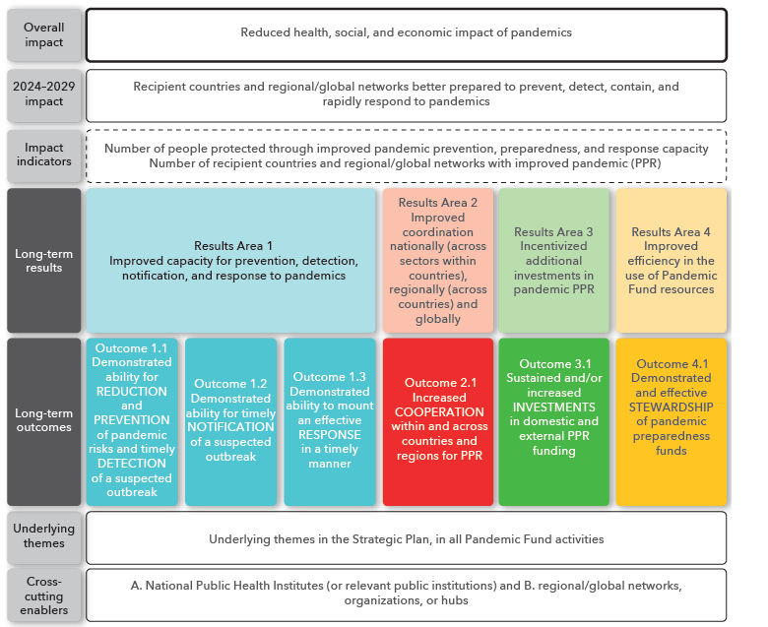
Theory of Change - Pandemic Fund Results Framework

Slide 21
Project Specific Results Framework
M&E Guidelines

Slide 22
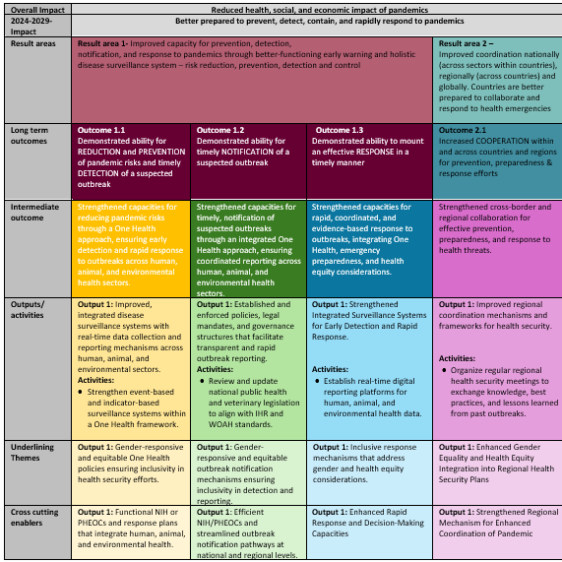
Project Specific Theory of Change

Slide 23
Project Specific Theory of Change
Proposals should include a detailed Theory of Change, demonstrating its connection to the overall impact and Results Areas outlined in the Pandemic Fund Results Framework.
It should include examples of long-term outcomes, intermediate outcomes, outputs, and related activities, with a particular focus on Results Areas 1 and 2.
Intermediate outcomes, outputs, and activities should also address Results Area 3 (Incentivized Additional Investments in Pandemic PPR) and Results Area 4 (Improved Efficiency in the Use of Pandemic Fund Resources).

Slide 24
Project Specific Indicators
Proposals should include a Project Specific Results Framework (PSRF) which should cover project level activities, outputs, and intermediate outcomes.
Each indicator in the PSRF will be defined/described, and will have data source, data collection methods, data type, analysis, and responsibilities for data management, are described in the Pandemic Fund Results Framework
Examples of project specific indicators are in the annex of the M&E Guidelines

Slide 25
Costed M&E Workplan
Proposals should include a Costed M&E workplan with a table that should specify
  Key M&E activities e.g. data collection, report writing, dissemination, M&E training/capacity building, etc.
  Responsibility for each activity
  Implementation timeline e.g. Year 1, 2, 3
  Budget by year

Slide 26
Scoring & Weighting Methodology
04

Slide 27



Scoring and Weighting Methodology
Provides the technical criteria to be used by the Technical Advisory Panel (TAP) to score the applications.
Provides the weights for each section that will determine the total weighted percentage of an application.
Sets the quality threshold per section and as an average for the whole application in order to be recommended by the TAP.

Slide 28
Scoring
Criteria are numerically aligned with the questions in the application template.
Each question includes 4-5 possible responses. The scoring descriptions are consistent (to the extent possible):
  Clear description
  Moderate description
  Limited description
  No description
A score will be assigned to each response, and the sum will constitute the total score for each application.

Slide 29
Weighting
Section |  | % of Total Score
A | Scope and objectives of the proposal, targeted Core Capacities, key activities and expected outcomes, and Theory of Change | 25
B | Context, demonstrated needs and alignment with national/regional priorities | 25
C | Co-financing, Co-investment, and overall available funding | 15
D | Ownership, Commitment, Coordination, Collaboration, and Co-creation | 15
E | Implementation and M&E | 20
TOTAL |  | 100%

Slide 30

Co-Financing
1
5
Definition:
Financial contribution from Implementing Entities (IEs) and/or other external sources - such as bilateral aid agencies, philanthropies, and private sector funders
Leverage ratio aspires to be US$ 1 : US$ 5 of co-financing.
These are aspirational leverage goals, there is no minimum threshold.

Slide 31
Co-Investment
0.7
1
4
1
LICs
LMICs, UMICs, HICs
Definition:
Financial resources including on-budget government funds that are available for implementation of the project.​
Leverage ratio aspirations depends on a country’s income level:
  LICs: US$ 1 : US$ 0.7
  LMICs, UMICs and HICs: US$ 1 : US$ 4
These are aspirational leverage goals, there is no minimum threshold.

Slide 32
Quality Thresholds for the TAP Evaluation
To be eligible for recommendation by the TAP, a proposal must satisfy 2 conditions:
Minimum score of 80% in each section (A-E)
Minimum average of 80% overall
80%
Section A
Section B
Section C
Section D
Section E

Slide 33
Accessing the CfP3 – Phase I Application Portal
05

Slide 34
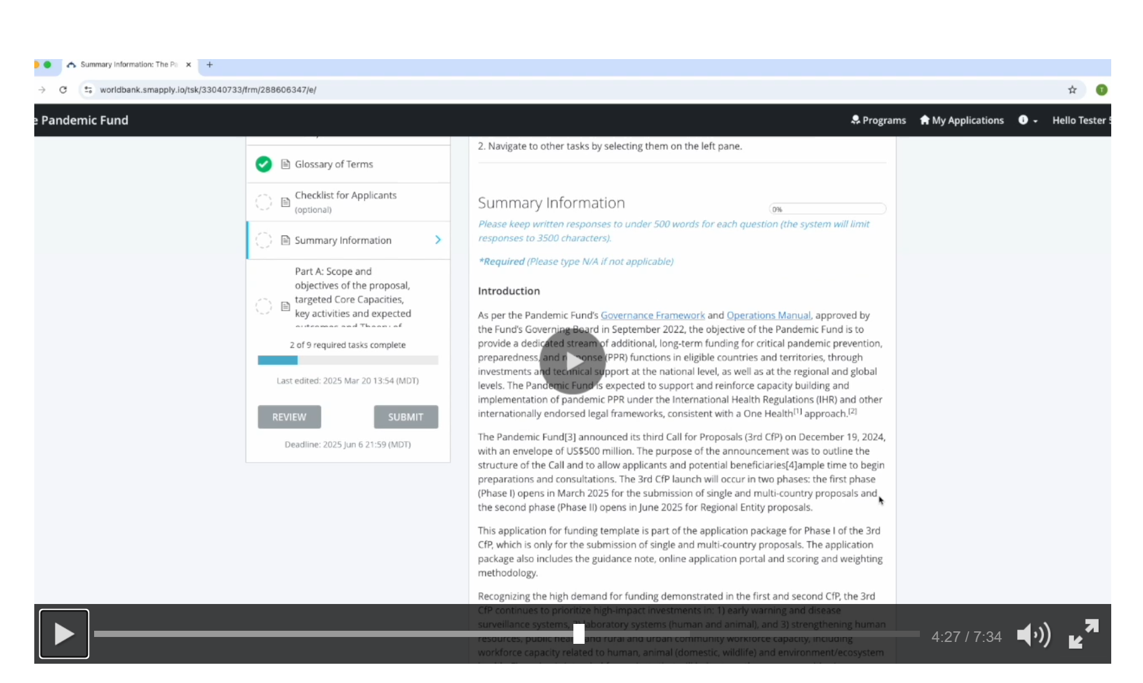
Video Tutorial on Applying
https://www.thepandemicfund.org/key-application-documents

Slide 35
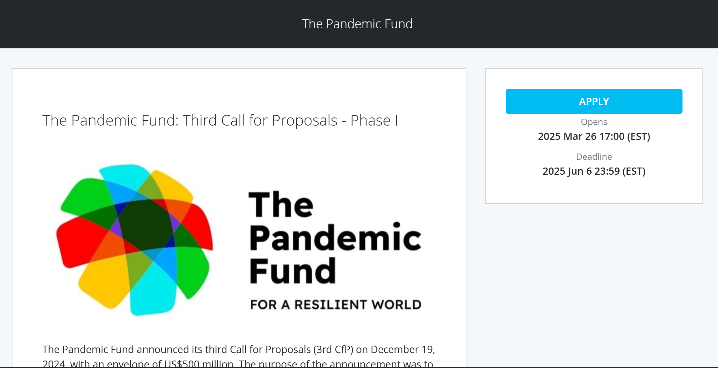




How to Submit Proposals
Where?
Completed applications must be submitted via the portal at:
https://worldbank.smapply.io/prog/CfP3_1/

Slide 36
Questions & Answers
05

Slide 37
Frequently Asked Questions
From April 1, 2025 Info Session

Slide 38
Are countries that received funding in the first or second calls eligible to apply for the third call?
Eligibility
Countries that received single-country grants are not eligible for another single-country grant, but MAY apply for one multi-country grant.
Countries that were part of a multi-country grant or Regional Entity proposal (but not a single-country proposal) are eligible to apply for one single-country grant and one multi-country grant in the 3rd CfP.
There is a table with different scenarios in the Guidance Note that might be helpful.

Slide 39
Do proposals need to demonstrate civil society engagement?
Coordination
We encourage the engagement of civil society organizations (CSOs) and other community-based organizations in the development of proposals submitted by Countries and / or Implementing Entities to the Pandemic Fund. Community engagement is one of the four underlying themes of PF projects as defined in the Pandemic Fund Strategic Plan. These organizations may also be contracted to serve as Delivery Partners during implementation.

Slide 40
How does an entity become an Implementing Entity (IE)?
Implementation
The Pandemic Fund has an established process for IE accreditation, which is done by an independent Accreditation Panel.
To date, 13 entities have signed Financial Procedures Agreements (FPAs) with the World Bank as Trustee. Any new applications from entities that wish to be accredited must submit applications to the Pandemic Fund Secretariat.

Slide 41
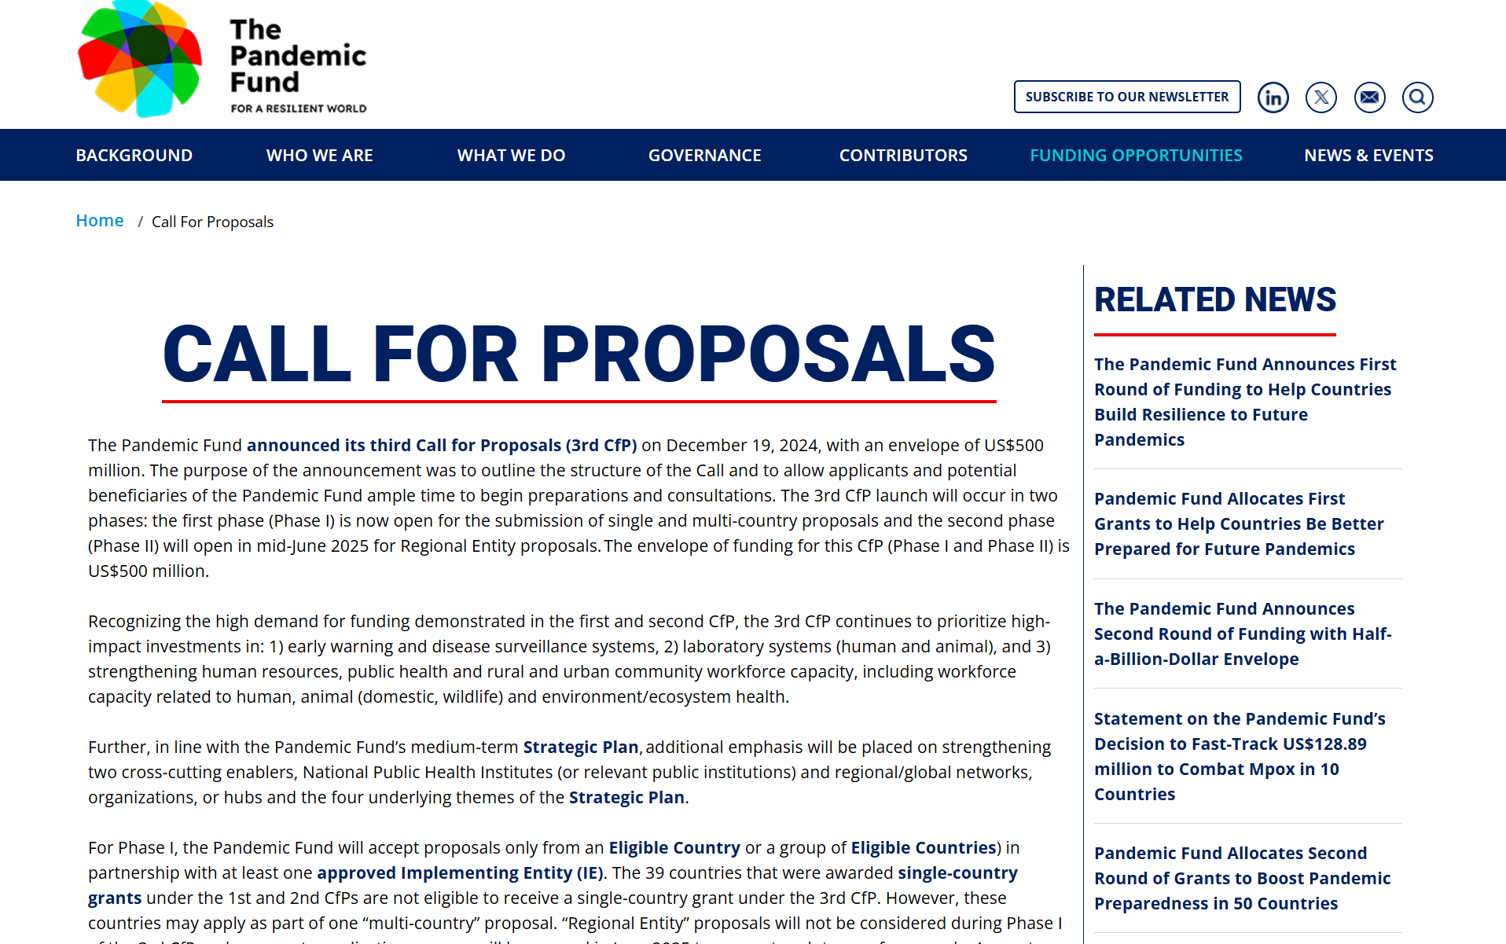
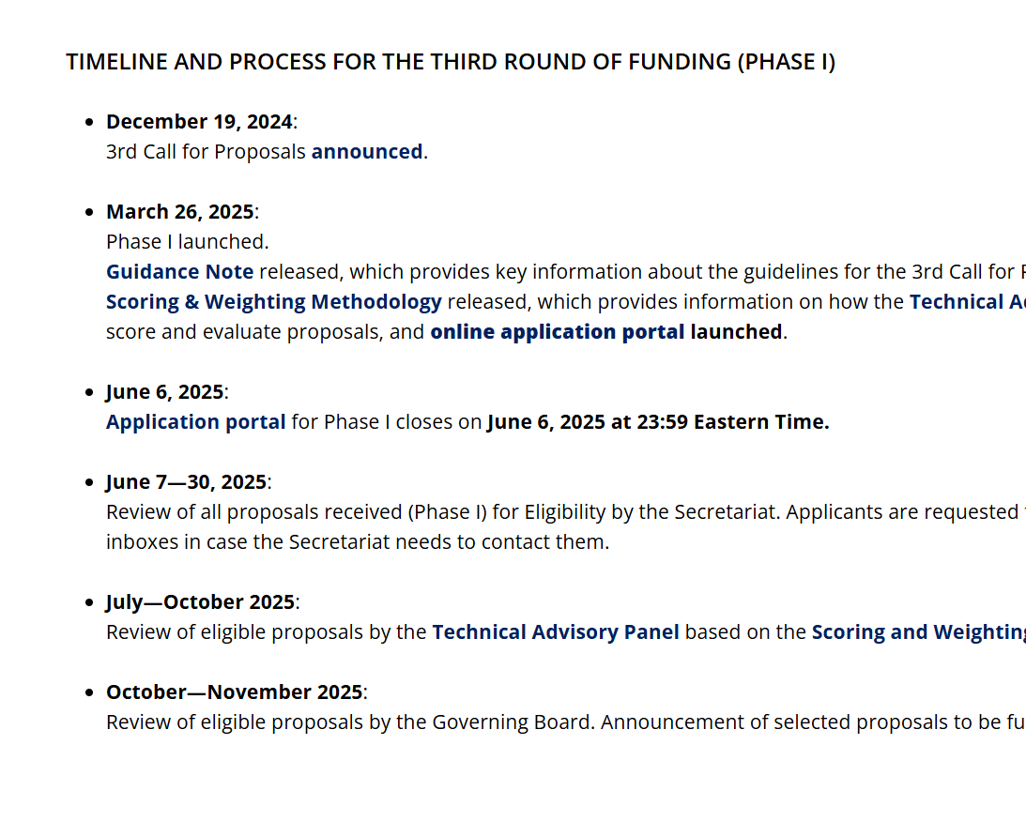
For More Information
Pandemic Fund website: https://www.thepandemicfund.org/call-for-proposals
Key information in the “Funding Opportunities” tab
Overview of process and key documents

Slide 42
Quick Links
Guidance Note was released in March 2025 and is available on the Pandemic Fund website in English, French (coming soon), and Spanish (coming soon).
Electronic Application Portal is now open. Information on how to access the portal – including a "how-to" video and FAQ – are available on the Pandemic Fund website.
Scoring and Weighting Methodology is available now (translations will be available in French and Spanish in mid-April 2025).
Application Template is available (translations will be available in French and Spanish in mid-April 2025).
Results Framework, Monitoring and Evaluation Guidelines, and Project Specific Results Framework (PSRF) and Associated Costs Excel Template are available now.
Information Sessions open to all prospective applicants on April 1 and April 7, 2025, with sign-up on the Pandemic Fund website. We will also post the slides and recordings.
Additional Questions? Please submit a ticket at the Helpdesk or Email us at: pandemicfundcfp@worldbank.org
Please follow us on social media for the most up-to-date information: X @Pandemic_Fund and LinkedIn.

Slide 43
Frequently Asked Questions

Slide 44
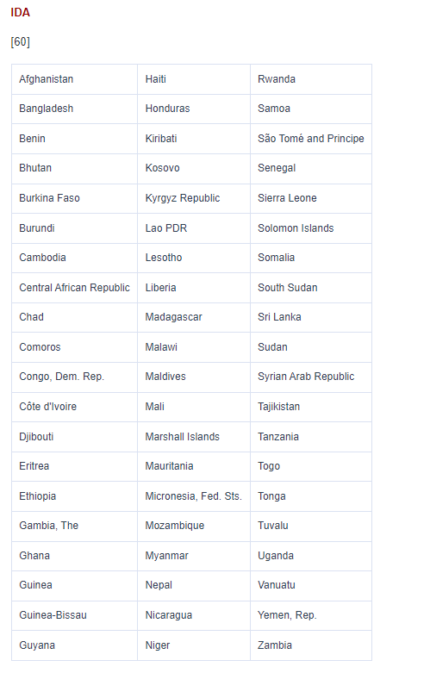
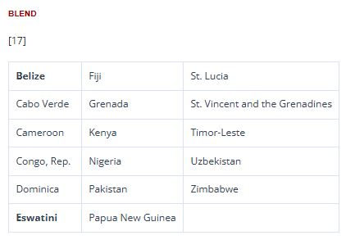
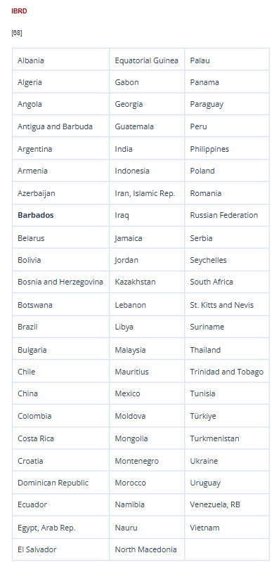
Where can I find the list of IDA/IBRD-eligible countries?
Eligibility
https://datahelpdesk.worldbank.org/knowledgebase/articles/906519-world-bank-country-and-lending-groups

Slide 45
Which eligible countries are not allowed to apply for single-country grants?
Eligibility
Countries that received single-country grants during the 1st and 2nd CfPs are not eligible to apply for single-country grants in the 3rd CfP.
These countries include:
Bhutan, Burkina Faso, Burundi, Cabo Verde, Cambodia, Chad, Democratic Republic of Congo, Egypt, Ethiopia, Fiji, Ghana, Georgia, Guyana, Honduras, India, Indonesia, Jordan, Kazakhstan, Lebanon, Moldova, Mongolia, Nepal, Nicaragua, Pakistan, Paraguay, Philippines, Rwanda, Samoa, Sierra Leone, South Africa, Sri Lanka, Suriname, Tanzania, Togo, Trinidad and Tobago, Tunisia, West Bank and Gaza, Yemen and Zambia.
These countries ARE eligible to participate in multi-country proposals

Slide 46
What is a Beneficiary?
Projects
A Beneficiary is any Eligible Country or Entity that may benefit from the Pandemic Fund through projects or activities undertaken by an IE to advance the objective of the Pandemic Fund. Such projects or activities can involve the government/public sector and private/non-governmental sector in Eligible Countries.

Slide 47
Are there submission limits?
Eligibility
YES, there are submission limits.
  An individual country may submit a maximum of one single-country proposal.
  An individual country may take part in a maximum of one multi-country proposal.
However, there are no limits on the number of proposals an IE may take part in.
All IEs should be in contact with each other to ensure the country limits are respected.

Slide 48
Is there a maximum amount of funding that can be requested?
Eligibility
Single-country proposals may request up to US$ 25 million.
Multi-country proposals may request up to US$ 40 million.

Slide 49
What is the expected duration of funding?
Projects
Proposals must demonstrate that they intend to use the grant financing within three years from the date of approval by the Implementing Entity’s (-ies) relevant authority, bearing in mind that the overall project completion date may extend beyond the three-year period.

Slide 50
For existing projects looking for additional funding from the Pandemic Fund, can the value of relevant project components be counted as co-financing / co-investment?
Financing
No, Pandemic Fund resources must be able to demonstrate additionality and catalytic impact.

Slide 51
Can we count co-financing and co-investment with a longer time horizon than the PF grant (e.g. >3 years)?
Financing
Yes, you should count the total value of co-financing and co-investment available for the lifespan of the project, even if that extends past the three-year grant of the Pandemic Fund.

Slide 52
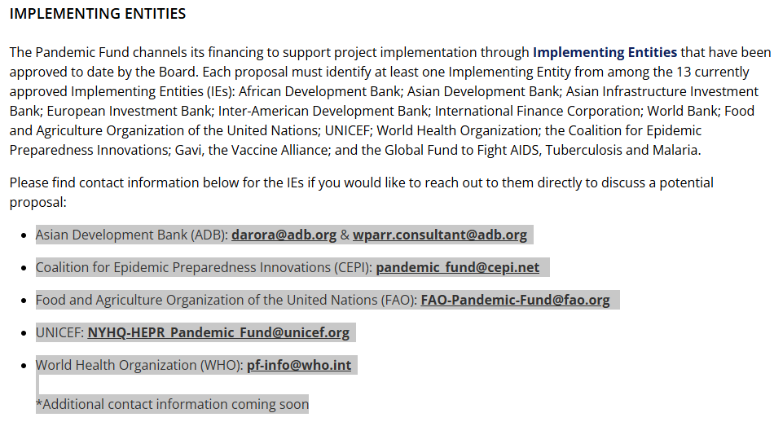
How can I contact an IE to potentially collaborate on a proposal?
Projects
Asian Development Bank(ADB) darora@adb.org & wparr.consultant@adb.org
Coalition for Epidemic Preparedness Innovation (CEPI) pandemic_fund@cepi.net
Food and Agriculture Organization of the United Nations (FAO) FAO-Pandemic-Fund@fao.org
UNICEF: NYHQ-HEPR_Pandemic_Fund@unicef.org
World Health Organization (WHO): pf-info@who.int
*Additional contact information coming soon on the website
You can find the list of IEs contacts and any future update in the Implementing Entities section of the webpage

Slide 53
By when do projects have to receive approval from the IE’s relevant authority to be considered?
Projects
The Pandemic Fund wants to support projects that will be able to accept funds as soon as possible. If there is conditional approval by the Pandemic Fund’s Board, the project should ideally be approved by the relevant authority of the IE within 6 months from the decision on the funding allocation. In the case of the 3rd CfP, IEs should be able to begin disbursing PF funds by March 31, 2026.

Slide 54
Can Implementing Entities also receive funds for project implementation? What about project execution?
Projects
The Trustee will pass on the grant to Implementing Entities which will channel funding to Beneficiary countries for carrying out project activities.
Implementing Entities may provide implementation and implementation support (e.g., M&E, analytical and advisory work, research) when needed. Activities that fall under this area should be reported in Table 1 in the Application as c) Project funds that will be used for implementation activities by IE.
On-the-ground execution and delivery of a project’s components should be carried out by the Beneficiary and/or Delivery Partners. IEs should only undertake these activities in exceptional circumstances where there is no viable alternative, and at the specific request of the Beneficiary.

Slide 55
What is the maximum “Administration Fee” for IEs that is allowed?
Projects
A cap on IE administrative fees at 7% (as a percentage of amount requested) has been instituted for activities related to preparation, administration and supervision of Pandemic Fund funds.
However, for projects operating in Challenging Operating Environments (COE), Fragile and Conflict-Affected Situations (FCS), Small Island Developing States (SIDS) contexts or other exceptional circumstances, the cap could be up to 10% of the grant amount requested by the IE, provided that the proposal includes a clear justification of the rationale behind the higher fee and substantiate this with evidence.

Slide 56
What is a delivery partner? Can a delivery partner submit a proposal?
Projects
A delivery partner is sub-contracted, using the IE’s procurement policies and procedures, to contribute to project execution and delivery on-the-ground.
Delivery partners may include CSOs, NGOs, private sector, academia, individuals, etc. They cannot submit proposals, however they should be consulted during the proposal development process and included in the proposal.

Slide 57
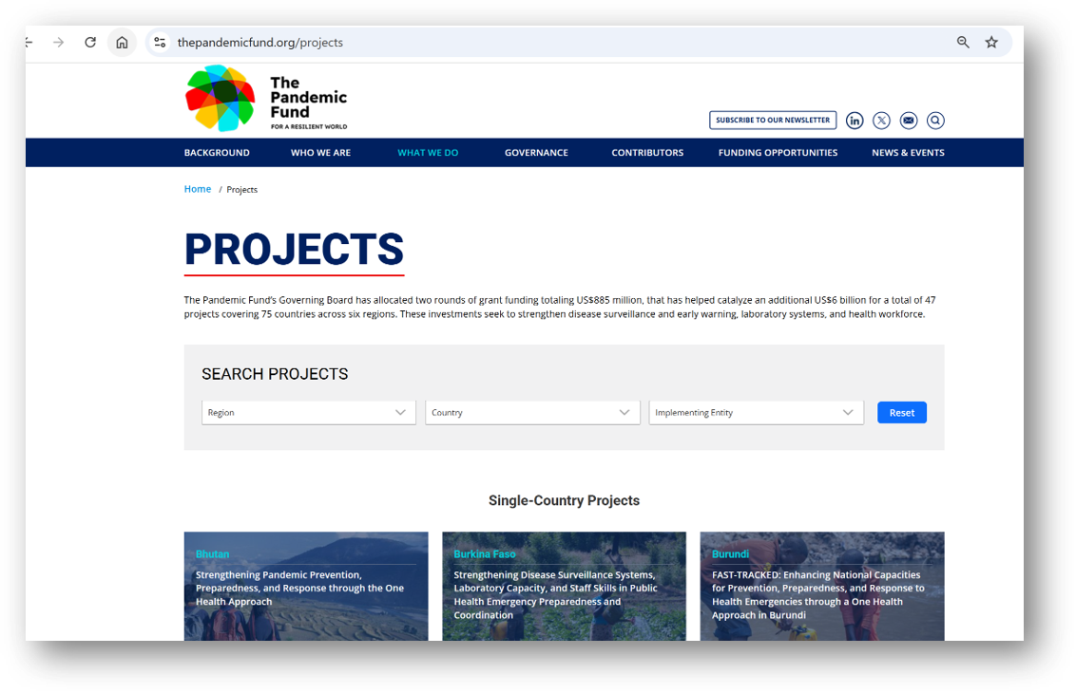
Where can I find examples of previously-approved PF projects?
Projects

Slide 58
Country Eligibility At-a-Glance
 | Eligible to apply for one single-country grant in the 3rd CfP? | Eligible to apply for one multi-country grant in the 3rd CfP?
Country was not awarded a single-country grant in the 1st or 2nd CfP | Yes | Yes
Country was awarded a single-country grant in the 1st or 2nd CfP | No | Yes
Country was part of a multi-country grant awarded in the 1st or 2nd CfP | Yes | Yes
Country was covered under a Regional Entity grant awarded in the 1st or 2nd CfP | Yes | Yes
Country awarded a single-country grant and was part of a multi-country grant awarded in the 1st or 2nd CfP | No | Yes
Country awarded a single-country grant and was covered under a Regional Entity grant awarded in the 1st or 2nd CfP | No | Yes

